Slide 1
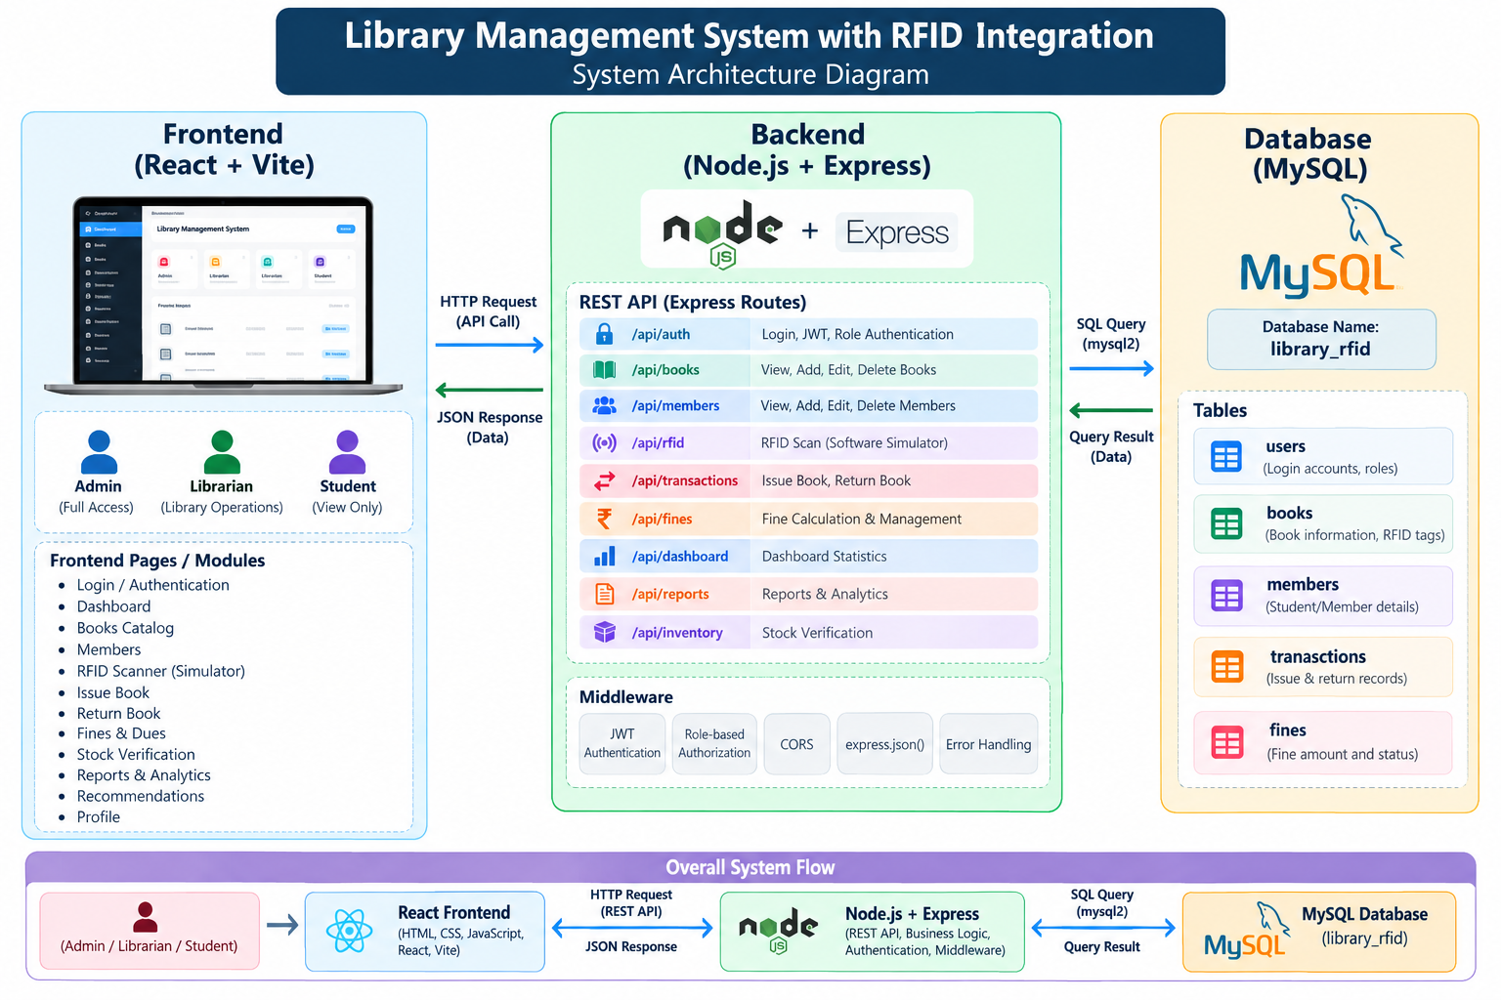
System Architecture
06

Slide 2

08
System Modules
  Catalog & RFID Tagging – Manage books and assign unique RFID tags for identification.
  Issue/Return Automation – Automate book issue and return using RFID scanning.
  Fine & Dues Management – Calculate and manage fines for overdue books.
  Member Management – Maintain and manage library member information.
  Book Recommendations – Provide recommendations based on available library titles.
  Stock Verification – Track book availability and verify library inventory.
  Reports – Generate reports related to books, members, transactions, fines, and stock.
STUDENT
RFID_TAG
FINE
One student → many transactions / One book → many transactions over time / Librarian manages circulation
RFID × DBMS / LIBRARY MANAGEMENT

Slide 3



09
RFID Workflow
1
Assign unique tag
2
Scan with reader
3
Retrieve RFID number
4
Query book record
5
Check availability
6
Record issue / return
RFID LIB00125
Database Management Systems
AVAILABLE
RFID × DBMS / LIBRARY MANAGEMENT

Slide 4


11
Advantages
01
02
03
04
FASTER
ACCURATE
REAL-TIME
LEANER
Issue and return
Automatic identification
Inventory availability
Less work, fewer errors
05
06
07
SAFER
CLEARER
CENTRAL
Fewer lost books
Instant reports
One shared database
RFID × DBMS / LIBRARY MANAGEMENT

